Slide 1

NVIDIA STOCK PRICE PREDICTION - TIME SERIES ANALYSIS AND FORCASTING
AND
MACHINE LEARNIG
NVIDIA STOCK PRICE PREDICTION - TIME SERIES ANALYSIS AND FORCASTING
AND
LINEAR MODEL

Slide 2
OBJECTIVES
THE OBJECTIVE OF ANALYSIS IS BY USING LINEAR MODEL, PREDICT THE VALUE AND COMPARE IT WITH ACTUAL VALUES AND ALSO DO THIRTY DAYS / ONE MONTH FUTURE PREDICTION. ALONG WITH LINEAR REGRESSION , WE ANALYSE THE DATA BY USING VARIOUS ASPECTS OF TIME SERIES LIKE TRENDS, SEASONALITY, MODELLING AND FORECASTING.

Slide 3
PROJECT DESCRIPTION
Machine Learning : Linear Regression
Import data →Data Preprocessing →Graphical visuals of the features in the dataset → Fitting the Linear model → Presenting the comparison between actual and predicted values → Going for thirty days prediction → Plotting the result.
Time Series Analysis and Forecasting
Graphical visuals of the features in the dataset 🡪 Stationary Check of the model 🡪 Finding out trend and seasonality 🡪 Performing seasonal decompose 🡪Followed by ARIMA model fiiting 🡪 Use the model for forecasting 🡪Lastly measuring the performance of the model.

Slide 4
CONTENTS
LINEAR REGRESSION
TIME SERIES ANALYSIS AND FORECASTING

Slide 5


INTRODUCTION ---NVIDIA
NVIDIA Corp.(NVDA) engages in the design and manufacture of computer graphics processors, chipsets, and related multimedia software. It operates through the Graphics Processing Unit (GPU) and Tegra Processor segments. The GPU segment comprises of product brands, which aims specialized markets including GeForce for gamers; Quadro for designers; Tesla and DGX for AI data scientists and big data researchers; and GRID for cloud-based visual computing users. The Tegra Processor segment integrates an entire computer onto a single chip, and incorporates GPUs and multi-core CPUs to drive supercomputing for autonomous robots, drones, and cars, as well as for consoles and mobile gaming and entertainment devices. The company was founded by Jen-Hsun Huang, Chris A. Malachowsky, and Curtis R. Priem in January 1993 and is headquartered in Santa Clara, CA.
Later on NVIDIA launched its Deep Learning courses (2009) for AI enhancement.
The NVIDIA Deep Learning Institute offers resources for diverse learning needs—from learning materials to self-paced and live training to educator programs—
giving individuals, teams, organizations, educators, and students what they need to
advance their knowledge in AI, accelerated computing, accelerated data science,
graphics and simulation, and more.

Slide 6
LITERATURE REVIEW
Kaleb Phipps , Martin Ratz , Dirk Muller , Veit Hagenmeyer and Ralf Mikut in their paper titled "REVIEW OF AUTOMATED TIME SERIES PIPELINE" (Feb , 2022) created a model using complex design which mainly included the sections data pre-processing , feature engineering , hyperparameter optimization , forecasting method selection and forecast ensembling organized in a pipeline structure . They used both Automated Machine Learning (AutoML) and automated statistical forecasting methods in a single pipeline for which they compared the automation methods for pipeline section and then analyzed automation methods regarding combination , interaction and coverage of the pipeline section. Finally they concluded that automation forecasting pipeline could be a large-scale process of time series forecasting and in future automation could be its one of the prime solution.
Julien Siebert , Janek Grob and Christof Schroth in the paper titled "A Systematic Review Of Python Packages for Time Series Analysis" (June , 2021) reviewed the packages that were used to analyse , classified the packages according to analysis tasks implemented and the means for evaluating the result. At last they their result concluded that forecasting is by far the most frequently implemented task and that half of the packages provide in gaining knowledge about data or generate synthetic data.
Wes McKinney , Josef Perktold and Skipper Seabold in the paper titled "Time Series Analysis in Python with Statsmodels" (2011) used time series analysis feature of scikits.statsmodels to show linear model classes , autoregressive , moving average , ARMA and Vector autoregressive models VAR. The process followed by setting up the ols parameters , then stationary check of unit roots , ARMA implementation and modelling and then finally using the VAR model to generate the forecast.

Slide 7
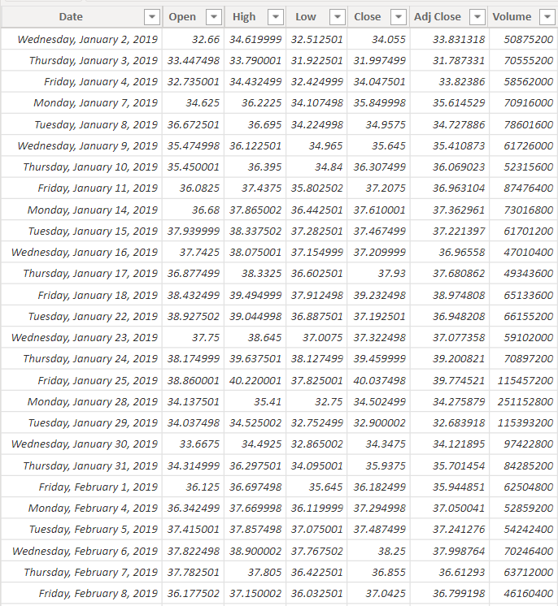
NVIDIA DATASET
A glimpse of our NVDA dataset.

Slide 8
NVIDIA DATASET INFORMATION
HIGH🡪 It show the high price a stock attained for a particular period of time.
LOW🡪 It show the low price a stock attained for a particular period of time.
CLOSE🡪 It show the closing prices of the stock for the same period.
OPEN🡪 It show the opening prices of the stock for the same period.
VOLUME🡪 The total amount of a security that changes hands over a given period of time.
ADJ-CLOSE🡪It amends a stock's closing price to reflect that stock's value after accounting for any corporate actions and often used when examining historical returns or doing a detailed analysis of past performance.
A stock’s closing price determines how a share performs during the day.
The close price is considered the reference point for any time frame. It’s the price traders agreed on after all the action throughout the day. When researching historical stock price data, one uses the closing price as the standard measure of the stock’s value as of a specific date.
We will be using this closing price for all of our analysis , forecasting and prediction.

Slide 9
LINEAR REGRESSION

Slide 10
MACHINE LEARNING
Machine Learning is the science (and art) of programming computers so they can learn from the data.
“Machine Learning is the field of study that gives computers the ability to learn without being explicitly programmed” – Arthur Samuel .
The example that the system uses to learn are called the Training Set.
Each training example is called a Training Instance / Sample.
Particular performance measure is called Accuracy.
ML is great for :-
ML algorithm can often simplify code and perform better.
ML techniques can find a solution for a complex problems.
ML system can adapt to new data such as fluctuating environments.
Getting insights about complex problems and large amount of data.

Slide 11
MACHINE LEARNING
Classic
Approaches
Data
Launch
Satisfied
Study the problem
Train ML algorithm
Evaluate solution
Not Satisfied
Analyze Errors

Slide 12
MACHINE LEARNING
Automate ML
Process
Update Data
Launch
Data
Can be automated
Automatically adapting
to change
Train ML Algorithm
Evaluate solution

Slide 13
TYPES OF MACHINE LEARNING
Supervised Learning – Training data we feed to the algo includes the desired solution called labels.
Example : Classification and Regression Models.
Unsupervised Learning – Training data is unlabeled ; the system tries to learn without a label.
Example : K Means , PCA , Association Rule Learning (such as Apriori)
Semisupervised Learning – Can deal with partially labeled training data .
Example : Simple combination of both supervised and unsupervised learning.
Reinforcement Learning – The learning system called an agent can observe the environment , select and perform actions , and get rewards in return.
Example : Robots

Slide 14
MACHINE LEARNING ALGORITHMS
Linear Regression
Logistic Regression
Decision Tree
SVM Algorithm
Naïve Bayes Algorithm
KNN Algorithm
Random Forest
K Means
Dimensionality Reduction Algorithm
AdaBoost Algorithm

Slide 15

SIMPLE LINEAR REGRESSION MODEL

Slide 16
SIMPLE LINEAR REGRESSION MODEL
The common terms used in simple linear regression model:-
Response – The variable we are trying to predict.
Independent Variable – The variable used to predict the response.
Record – The vector of predictor and outcome values for a specific individual or case.
Intercept – The intercept of regression line , i.e. the predicted value when X=0 .
Regression Coefficients – The slope of the regression line.
Fitted Values – The estimates obtained from regression line.
Residuals – The difference between the observed values and the fitted values.
Least Squares – The method of fitting a regression by minimizing the sum of squared of residuals .

Slide 17

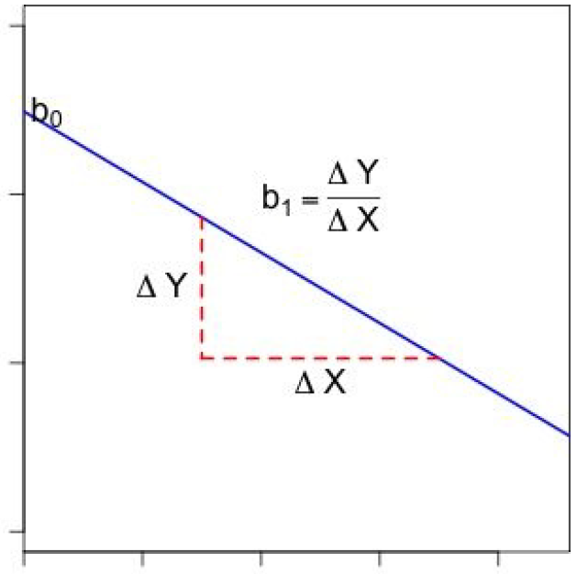
SIMPLE LINEAR REGRESSION MODEL

Slide 18
DATA ANALYSIS (DATA PREPROCESSING)
Once the data is available, it needs some pre-processing so that it can be fed to a machine learning model. The significance of the output depends on the pre-processing of the data.
Importing the Libraries
import pandas as pd
import numpy as np
import seaborn as sns
import warnings
warnings.filterwarnings('ignore')
import matplotlib.pyplot as plt
plt.style.use('seaborn')
from sklearn.linear_model import LinearRegression
from sklearn.model_selection import train_test_split
from sklearn.metrics import accuracy_score
from sklearn.metrics import mean_squared_error
from matplotlib.pyplot import figure
from sklearn.metrics import r2_score

Slide 19
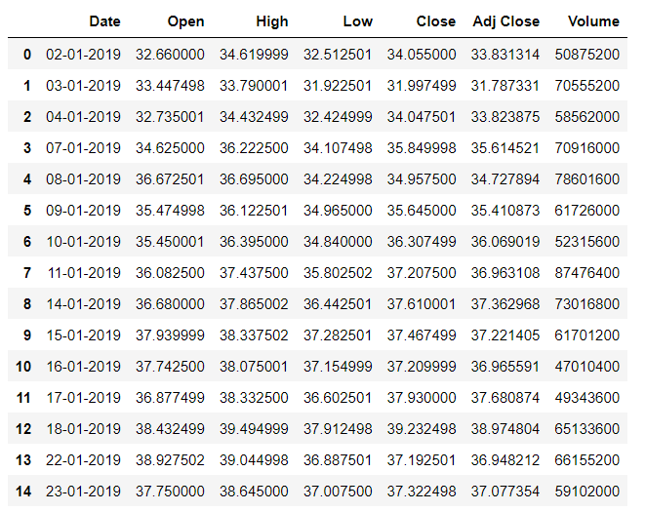
DATA ANALYSIS (DATA PREPROCESSING)
Reading the Data
There are five columns.
The Open column tells the price at which a stock started trading when the market opened on a particular day.
The Close column refers to the price of an individual stock when the stock exchange closed the market for the day.
The High column depicts the highest price at which a stock traded during a period.
The Low column tells the lowest price of the period.
Volume is the total amount of trading activity during a period of time.

Slide 20
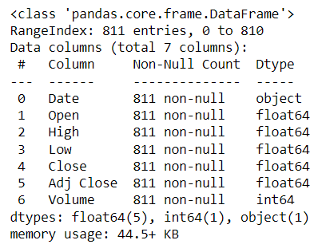
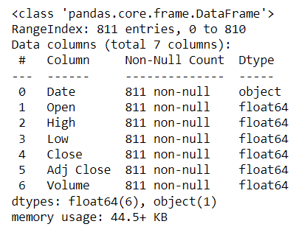
DATA ANALYSIS (DATA PREPROCESSING)
Checking the dataset information
In our data set , we observe all column values are in float data type , except the Volume which is an integer type.
Before we proceed we convert the Volume into a float data type

Slide 21
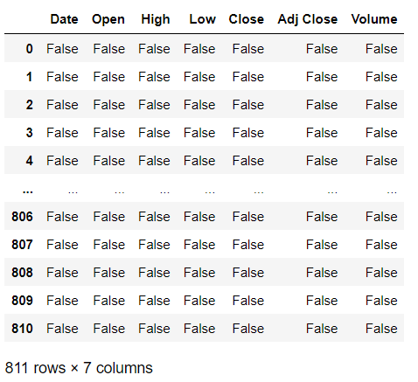
DATA ANALYSIS (DATA PREPROCESSING)
Checking whether null/NaN values are present or not
In the data set there is no null/NaN values present.
Wooow a perfect dataset with no missing values

Slide 22
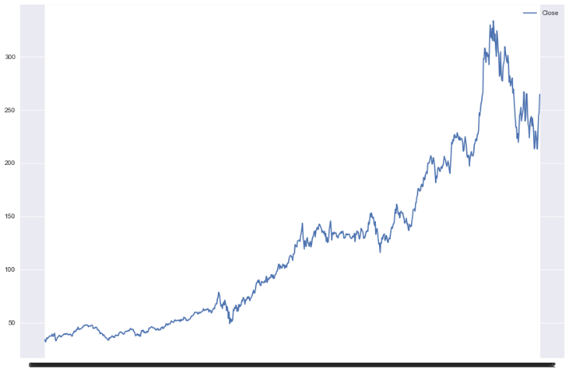
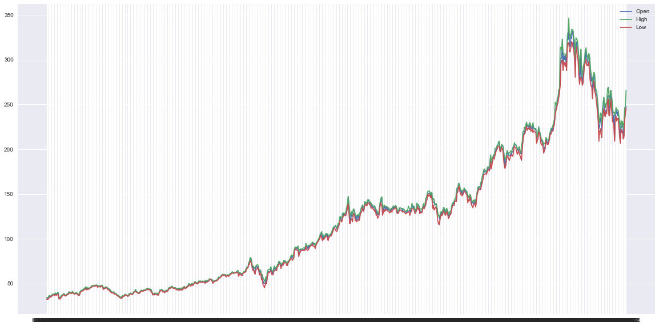
DATA ANALYSIS (DATA PREPROCESSING)
Data Visualization
This is a graphical representation of closed values based on dates.
Trend of open, low and high price with respective of dates.

Slide 23
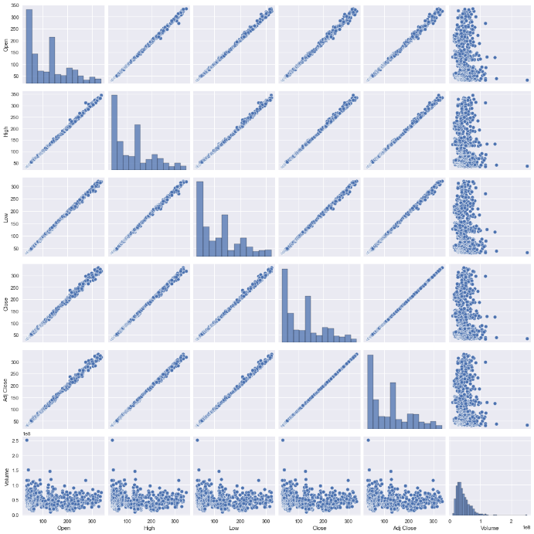
DATA ANALYSIS (DATA PREPROCESSING)
Pair plot helps to visualize the data and describes the relationship between two variables i.e. they are continuous or categorical. Pairplot is a module of seaborn library which provides a high-level interface for representing attractive and informative statistical graphics.
From the picture below, we can observe the relationship in each plot.
Here we can see data is continuous.
The plots are in matrix format where the row name x axis represents and column name represents the y axis. The main-diagonal subplots are the univariate histograms (distributions) for each attribute. The linear straight line between the attributes clearly represent that there is positive correlation between variables.

Slide 24
DATA ANALYSIS (DATA PREPROCESSING)
Model Fitting
Firstly we consider ,
x=['Open','High','Low','Volume']
y=['Close']
Then using train_test_split we split the data with test size 0.2 to create linear model for prediction of close price. After that we create a data frame of actual and predicted values and compare it with each other.

Slide 25
PREDICTIONS

Slide 26
PREDICTIONS
Historically , a prime use of regression was to illuminate a supposed linear relationship between predictor variable and an outcome variable. The goal has been to understand a relationship and explain it using the data that the regression was fit to.
With the advent of big data , regression is widely used to form a model to predict individual outcomes for new data , rather than explain data in hand.
A regression model that fits the data well is setup such that the changes in X lead to changes in Y.

Slide 27
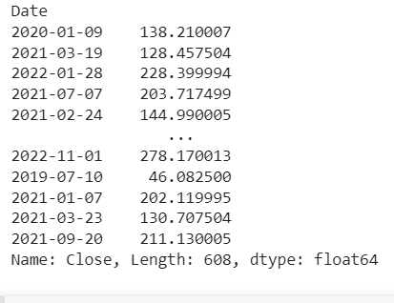
RESULTS AND INTERPRETATIONS
Prediction
Here we try to predict the close value .
We observe that there is not much difference in actual and predicted values.
We check the accuracy of the prediction by using R^2 score.
r2_score(predicted,y_test)=0.9994739616773841

Slide 28
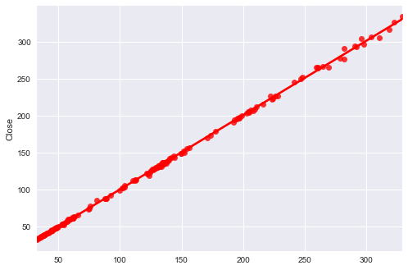
RESULTS AND INTERPRETATIONS
Prediction
This is also we show that by using graph of Comparison of Actual Value v/s Predicted Values.
The graph clearly represents that there is not a lot of dispersion between actual value and the predicted value. It signifies good accuracy of the predicted values and we can move further for the forecasting method.

Slide 29
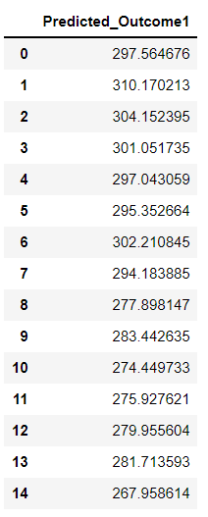
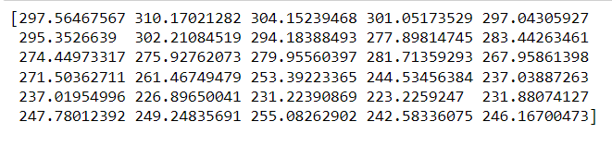
RESULTS AND INTERPRETATIONS
Future One month or Thirty Days Prediction
From the past values of close price we try to predict the future thirty days or one month values of Close price.
Complete thirty days(6x5)
Prediction.

Slide 30
TIME SERIES

Slide 31
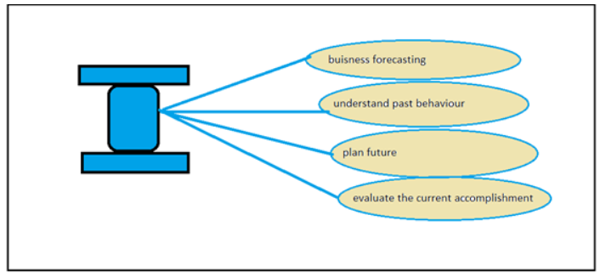
TIME SERIES ANALYSIS AND FORECASTING
Time series forecasting is like other machine learning algorithms used for prediction of any dependent values or features. In supervised machine learning there are many algorithms like linear and logistic regression which we use to predict output with the help of mapping functions, which map dependent to independent values. But, in time series forecasting we have only one variable that is time corresponding, to which we train our model and predict the future values with the help of previous time data. We do this because there is some type of pattern or trend found in our time data in measured intervals. We use this to analyze our time data.
Time series is a set of observations taken at specified times, usually at equal intervals like day, month, week, year, or any measure of time. It is used to predict future values on the basis of previous observed values.
From the above we see that we can use time series forecasting for things like business models, weather forecasting, sales forecasting,or pandemic forecasting over an instance of time.
Business forecasting
Weather forecasting
Pandemic forecasting

Slide 32
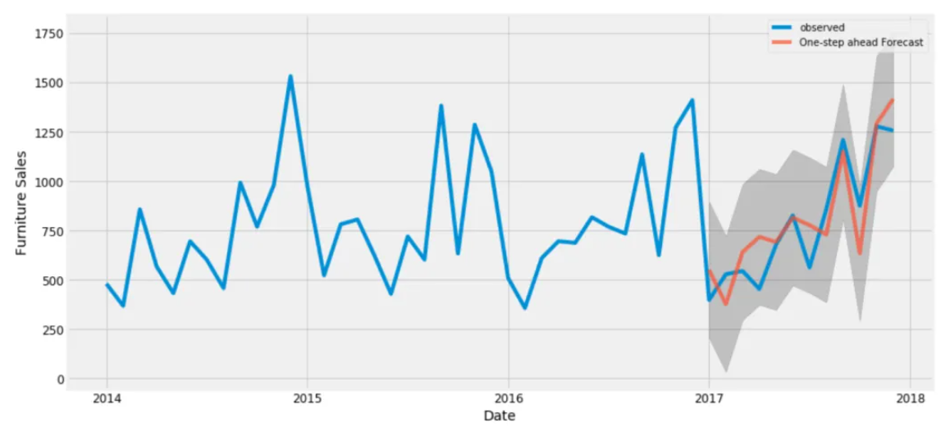
TIME SERIES ANALYSIS AND FORECASTING
CLASSIC DEFINITION
A Time series is a set of observations, each one being recorded at a specific time. It decomposes the past historical data to depict the trend, seasonality, and noise to derive the future trends from it. It’s a type of predictive analysis that forecasts the value of a variable in future occurrences based on history. The predicted values can be influenced by certain external factors which are known as independent variables like in the case of temperature on a particular day is influenced by the humidity or wind speed.
A discrete time series is one in which the set of time points at which observations are made is a discrete set.
Continuous time series are obtained when observations are made continuously over some time intervals.

Slide 33
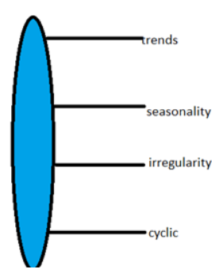
TIME SERIES ANALYSIS AND FORECASTING
Components of Time Series are :-
Trend 🡪 Steady upward or downward movement with little fluctuations over a period of time.
Eg. Increase / Decrease in profit generation .
Seasonal Variations🡪Short term fluctuations in a time series which occur periodically within a year.
Eg. Selling of Umbrellas in the monsoon season.
Cyclical Variations 🡪Recurrent upward / downward movement in a time series but the period of the cycle is greater than a year(not for a fixed period).
Eg. Business Cycle
Irregular Variations 🡪Fluctuations of short term , erratic in nature , regularity (random) in occurance.
Eg. Natural Calamities , Sudden Poverty.

Slide 34
TIME SERIES ANALYSIS AND FORECASTING
Objectives of this section :-
Sequence of observation(s) , broken into components and then to study underlying structure.
Followed by finding out trend and stationary of the dataset and then taking necessary steps to remove them.
Now using this new data to create a new model for further analysis through certain technique----AR+I+MA.
Once the model has been created , we use the model for forecasting by applying certain methods.

Slide 35
STEPS FOR BOTH ANALYSIS AND PREDICTION - PIPELINE
Importing the Nvidia Stock Market dataset.
Importing the necessary libraries for analysis and forecasting.
Checking out the null values of the dataset.
Plotting the various visuals of the features in dataset and showing their comparison over the years.
Checking the model for stationary through a certain test.
Applying Seasonal Decomposing method to separate trend and stationarity.
Then followed by Detrending a time series data.
Successively followed by a Deaseasonalizing time series data.
Calculating and plotting the rolling average.
Now splitting the data into test and train set for model creation.
Calling the auto_arima function to set up the best ARIMA model with parameters p,d,q.
Finally , using the data for forecasting .

Slide 36
NVIDIA DATASET
A glimpse of our NVDA dataset.

Slide 37
NVIDIA DATASET INFORMATION
HIGH🡪 It show the high price a stock attained for a particular period of time.
LOW🡪 It show the low price a stock attained for a particular period of time.
CLOSE🡪 It show the closing prices of the stock for the same period.
OPEN🡪 It show the opening prices of the stock for the same period.
VOLUME🡪 The total amount of a security that changes hands over a given period of time.
ADJ-CLOSE🡪It amends a stock's closing price to reflect that stock's value after accounting for any corporate actions and often used when examining historical returns or doing a detailed analysis of past performance.
A stock’s closing price determines how a share performs during the day.
The close price is considered the reference point for any time frame. It’s the price traders agreed on after all the action throughout the day. When researching historical stock price data, one uses the closing price as the standard measure of the stock’s value as of a specific date.
We will be using this closing price for all of our analysis , forecasting and prediction.

Slide 38
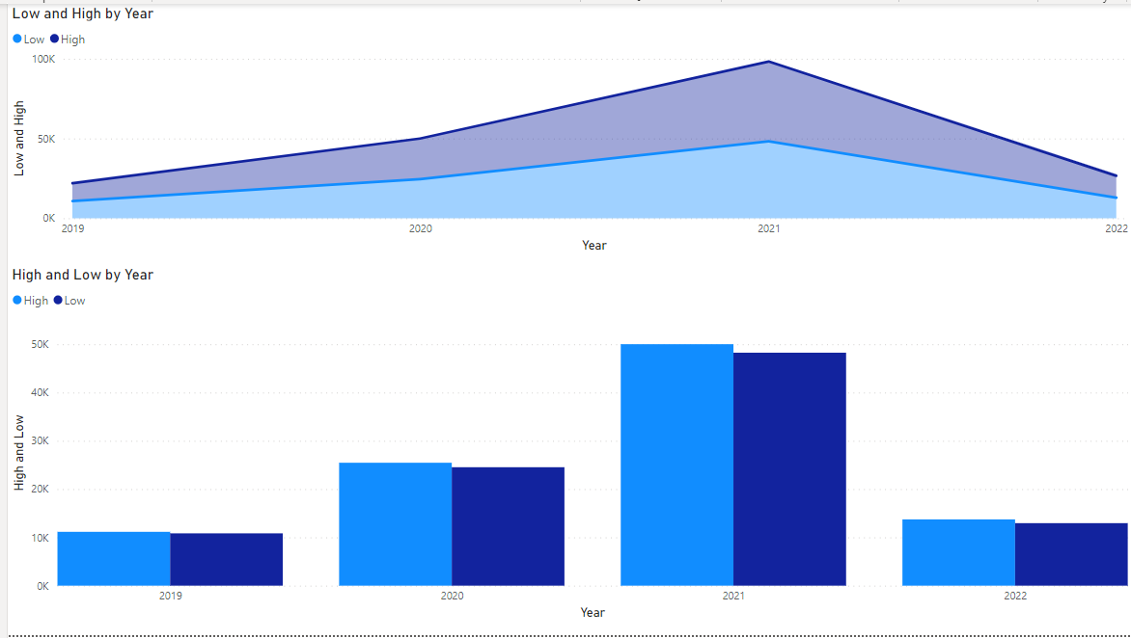
GRAPHICAL VISUAL 1---OPEN VS CLOSE AND LOW VS HIGH

Slide 39
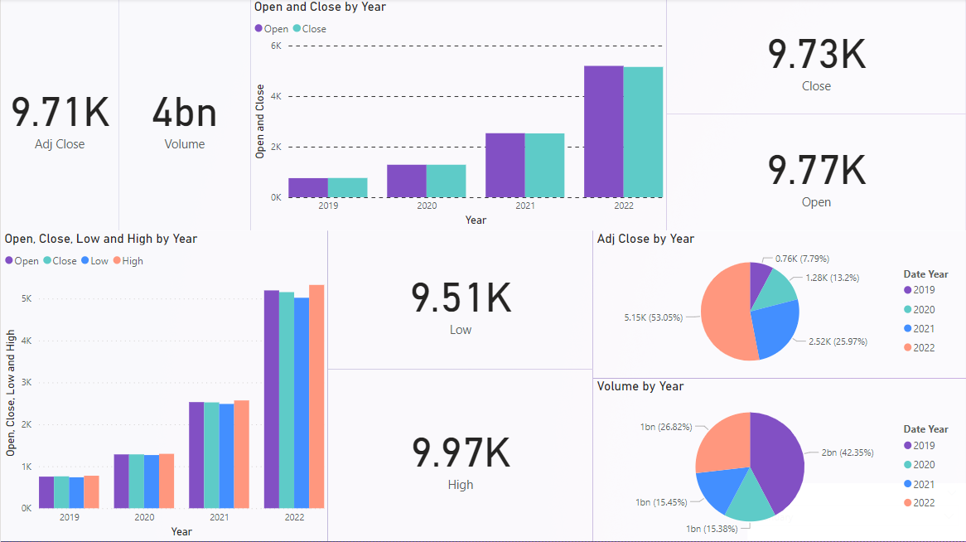
GRAPHICAL VISUAL 2---COMPLETE DASHBOARD
A complete dashboard showing all the components of a stock market until March 2022.
From the visuals we can easily detect and say that there has been an growth among all the components and there by showing an increasing rate of trend.

Slide 40
TIME SERIES STATIONARY MODEL
The Time series data model works on stationary data. The stationarity of data is described by the following three criteria:-
1) It should have a constant mean (the average value of all the data)
2) It should have a constant variance (difference of each point value from the mean)
3) Auto covariance(a relationship between any two values at a certain amount of time) does not depend on the time .
There are two methods in python to check data stationarity:-
1) Rolling statistics
2) Augmented Dickey- fuller Test (ADCF)

Slide 41
ROLLING STATISTICS / ROLLING MEAN
A moving average, also called a rolling or running average or mean , is used to analyze the time-series data by calculating averages of different subsets of the complete dataset. Since it involves taking the average of the dataset over time, it is also called a moving mean (MM) or rolling mean.
There are various ways in which the rolling average can be calculated, but one such way is to take a fixed subset from a complete series of numbers. The first moving average is calculated by averaging the first fixed subset of numbers, and then the subset is changed by moving forward to the next fixed subset (including the future value in the subgroup while excluding the previous number from the series).
One of the wats to calculate is we start by taking a log of the series to reduce the magnitude of the values and reduce the rising trend in the series. Then after getting the log of the series, we find the rolling average of the series. A rolling average is calculated by taking input for the past TWELVE months and giving a mean consumption value at every point further ahead in series.

Slide 42
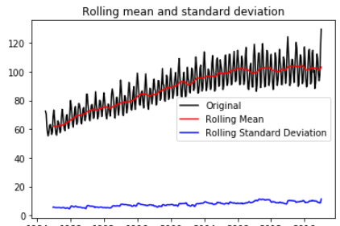
ROLLING STATISTICS / ROLLING MEAN
This method gave a visual representation of the data to define its stationarity. A Moving variance or moving average graph is plot and then it is observed whether it varies with time or not. In this method, a moving window of time is taken (based on our needs, for eg-10, 12, etc.) and then the mean of that time period is calculated as the current value.
There are various ways in which the rolling average can be calculated, but one such way is to take a fixed subset from a complete series of numbers. The first moving average is calculated by averaging the first fixed subset of numbers, and then the subset is changed by moving forward to the next fixed subset (including the future value in the subgroup while excluding the previous number from the series).

Slide 43
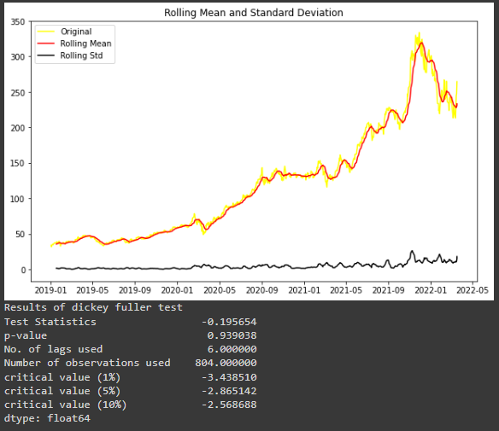
ADF (AUGMENTED DICKEY-FULLER) TEST
The DickeyFuller test is one of the most popular statistical tests. It can be used to determine the presence of unit root in the series.
So it help us understand if the series is stationary or not.
The null and alternate hypothesis of this test is:
(*)Null Hypothesis: The series has a unit root (value of a =1)
(*)Alternate Hypothesis: The series has no unit root.
If we fail to reject the null hypothesis, we can say that the series is nonstationary. This means that the series can be linear or difference stationary.
If both mean and standard deviation are flat lines(constant mean and constant variance), then series becomes stationary.

Slide 44
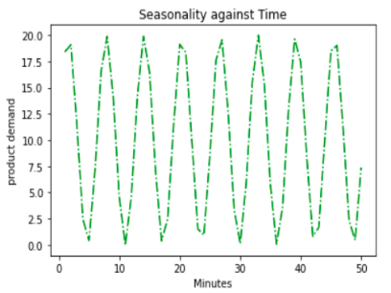
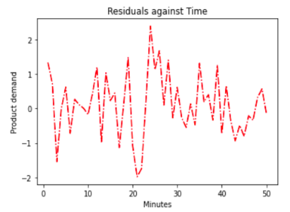
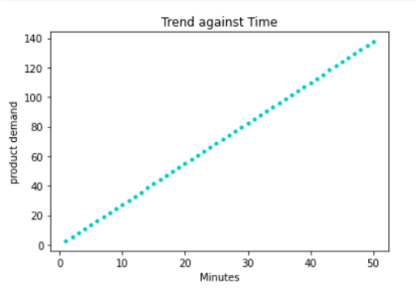
SEPARATION OF TREND AND SEASONALITY
As we know there are few components of time series , mainly
Seasonality: Describes the periodic signal in your time series.
Trend: Describes whether the time series is decreasing, constant, or increasing over time.
Noise / Residual : Describes what remains behind the separation of seasonality and trend from the time series.

Slide 45
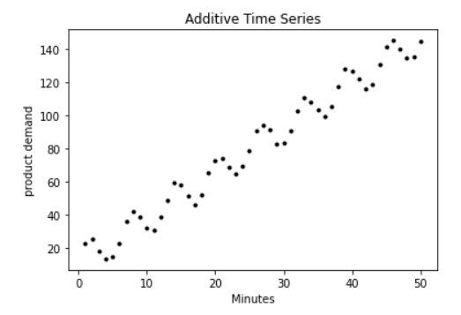
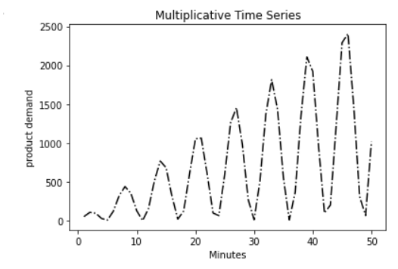
SEPARATION OF TREND AND SEASONALITY
Time series decomposition is a technique that splits a time series into several components, each representing an underlying pattern category, trend, seasonality, and noise. Decomposition provides a useful abstract model for thinking about time series generally and for better understanding problems during time series analysis and forecasting.
An additive model suggests that the components are added together as follows :
Level + Trend + Seasonality + Noise
An additive model is linear where changes over time are consistently made by the same amount.
A multiplicative model suggests that the components are multiplied together as follows:
Level * Trend * Seasonality * Noise
A multiplicative model is nonlinear, such as quadratic or exponential. Changes increase or decrease over time.

Slide 46
SEASONAL DECOMPOSE
But why would we decompose a time series?
Time series decomposition is used in time series analysis for tasks such as:
exploratory data analysis (e.g., has unemployment increased this quarter after adjusting for seasonality?);
pre-processing time series to identify and impute outliers and missing data;
extracting features from time series for later use in classification, regression, and forecasting tasks;
building forecasts (e.g., the components can be forecasted separately and then aggregated to produce the final forecast).
Time series decomposition is about breaking up a time series into components, most notably: a trend component, a seasonal component, and a residual component. There are many methods to decompose a time series with a single seasonal component implemented in Python.
Some commonly used methods for time series decomposition include:
Naïve Method.
Seasonal Trend Decomposition.
X-13-ARIMA SEATS.

Slide 47
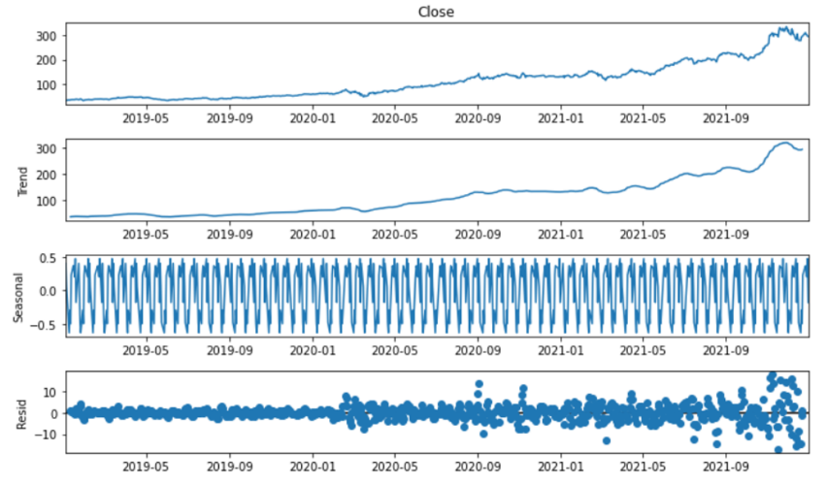
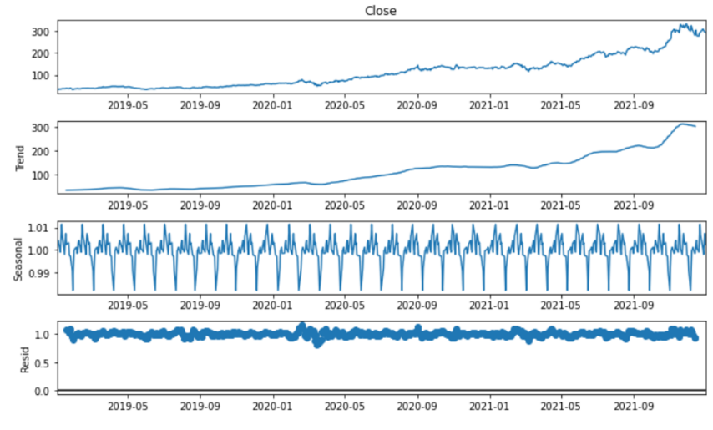
SEASONAL DECOMPOSE
The below graphs shows the seasonal decompose where actual , trend , seasonality and residual has been decomposed.
The first graph shows the plot with additive trend while the second one shows the multiplicative trend.
The graphs shows additive trend where frequency or period equals twelve.
The graphs shows multiplicative trend where frequency or period equals twelve.

Slide 48
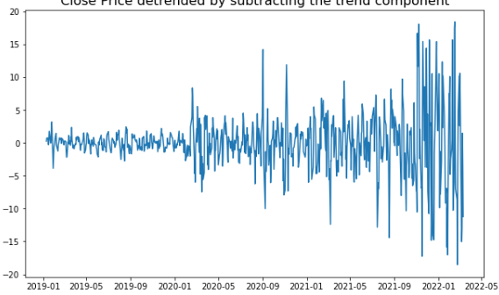
TIME SERIES --DETREND TIME SERIES DATA
Detrending a time series means to remove the trend component from the time series.
There are multiple approaches of doing this as listed below:
We subtract the line of best fit from the time series.
For more complex trends, we may want to use quadratic terms (x^2) in the model.
We subtract the trend component obtained from time series decomposition.
We subtract the mean.
Apply a filter like Baxter-King filteror the Hodrick-Prescott Filter to remove the moving average trend lines or the cyclical components.

Slide 49
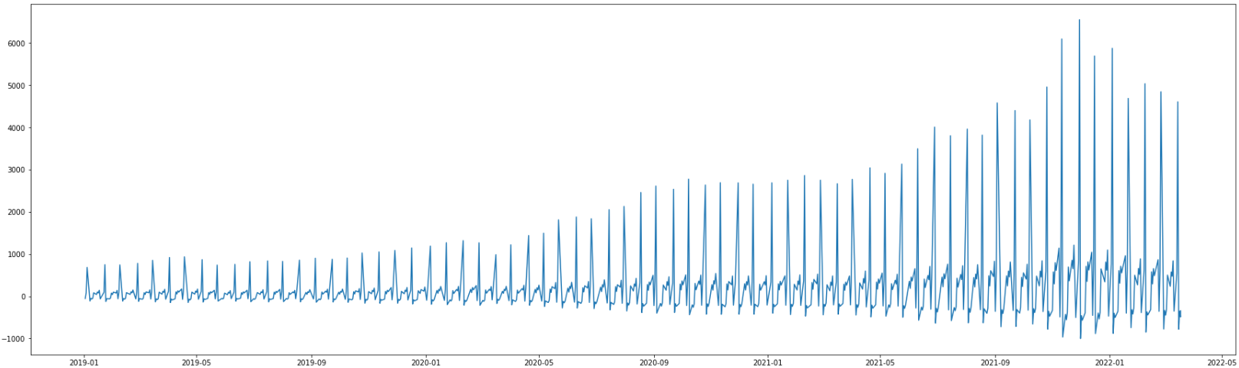
DESEASONALIZE TIME SERIES DATA
In many cases, seasonal patterns are removed from time-series data when they are released on public databases. Data that has been stripped of its seasonal patterns is referred to as seasonally adjusted or Deseasonalized data.
There are multiple approaches to deseasonalize a time series.
These approaches are listed below:
We take a moving average with length as the seasonal window. This will smoothen in series in the process.
Seasonal difference the series (i.e. to subtract the value of previous season from the current value).
Then to divide the series by the seasonal index obtained from decomposition.
If dividing by the seasonal index does not work well, we will take a log of the series and then do the deseasonalizing.
We can later restore to the original scale by taking an exponential.

Slide 50
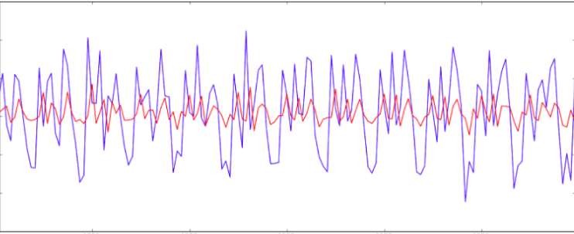
TIME SERIES MODEL – AR(P) MODEL
The autoregressive model uses observations from preivous time steps as input to a regression equations to predict the value at the next step. The AR model takes in one argument, p, which determines how many previous time steps will be inputted.
The order, p, of the autoregressive model can be deterimined by looking at the partial autocorrelation function (PACF). The PACF gives the partial correlation of a stationary time series with its own lagged values, regressed of the time series at all shorter lags.

Slide 51
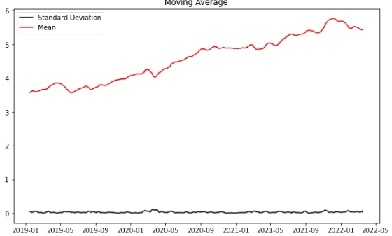
TIME SERIES MODEL – MA(Q) MODEL
A moving average, also called a rolling or running average, is used to analyze the time-series data by calculating averages of different subsets of the complete dataset. Since it involves taking the average of the dataset over time, it is also called a moving mean (MM) or rolling mean.
The moving average model is a time series model that accounts for very short-run autocorrelation. It basically states that the next observation is the mean of every past observation. The order of the moving average model, q, can usually be estimated by looking at the ACF plot of the time series.
We start by taking a log of the series to reduce the magnitude of the values and reduce the rising trend in the series. Then after getting the log of the series, we find the rolling average of the series. A rolling average is calculated by taking input for the past 12 months and giving a mean consumption value at every point further ahead in series.

Slide 52

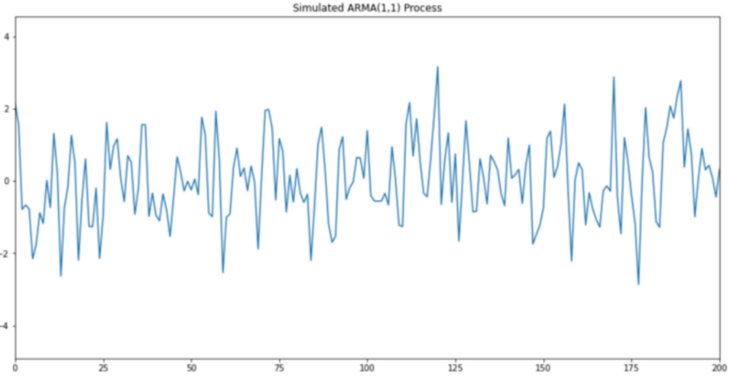
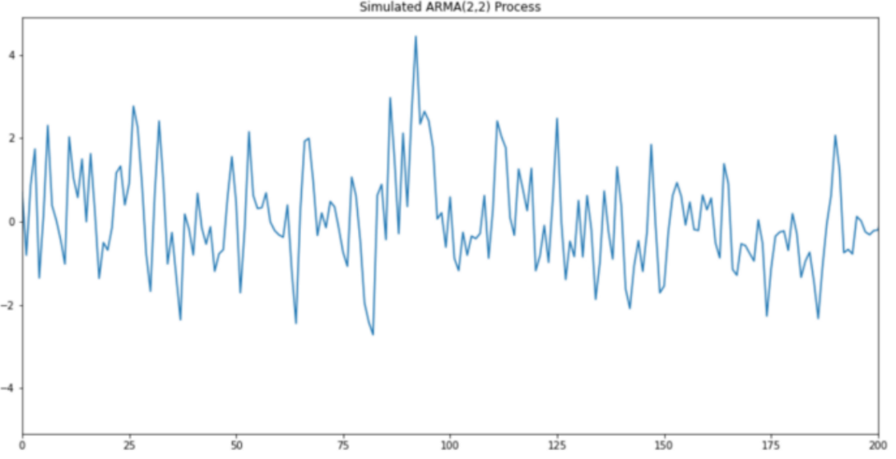
TIME SERIES MODEL – ARMA(P,Q) MODEL
The following above graph shows specific ARMA models when p=1 , q=1 , i.e. ARMA(1,1) process and when p=2 , q=2 , i.e. ARMA(2,2) process.

Slide 53
TIME SERIES MODEL – ARIMA (P,D,Q) MODEL
ARIMA is an acronym that stands for Auto-Regressive Integrated Moving Average. It is a class of model that captures a suite of different standard temporal structures in time series data.
An ARIMA model is a class of statistical models for analyzing and forecasting time series data. It is really simplified in terms of using it, yet this model is really powerful.
ARIMA used only when the data is non-stationary as in our case while ARMA follows the stationarity rule.
The parameters of the ARIMA model are defined as follows:
p: The number of lag observations included in the model, also called the lag order.
d: The number of times that the raw observations are differenced, also called the degree of difference.
q: The size of the moving average window, also called the order of moving average.

Slide 54

TIME SERIES MODEL – ARIMA (P,D,Q) MODEL

Slide 55
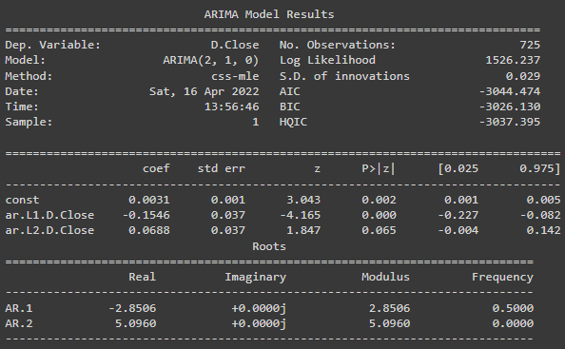
TIME SERIES MODEL – SIMPLE ARIMA MODEL
The basic information is pretty self-explanatory:
Dep. Variable – What we’re trying to predict.
Model – The type of model we’re using. AR, MA, ARIMA.
Date – The date we ran the model
Time – The time the model finished
Sample – The range of the data
No. Observations – The number of observations
This is of specific model (2,1,0) [(p,d,q)]
The dependent variable is the close, which we’re trying to predict. The independent variables are the constant beta. The error term is sigma2 or epsilon in our general equation.
Therefore, we want each term to have a p-value of less than 0.05, so we can reject the null hypothesis with statistically significant values.

Slide 56
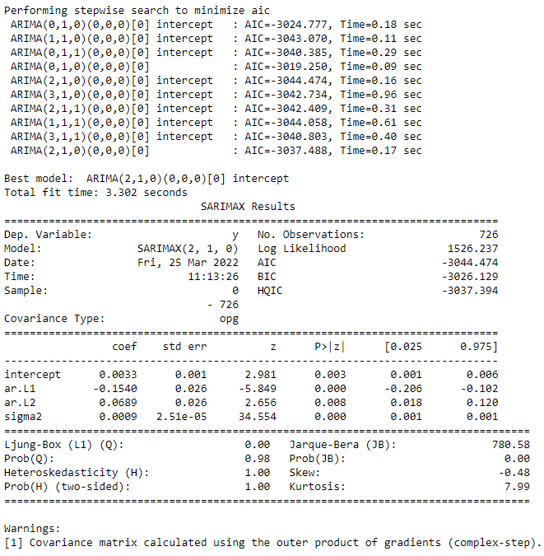
TIME SERIES MODEL – AUTO ARIMA MODEL
Auto ARIMA: Automatically discover the optimal order for an ARIMA model.
The auto_arima function seeks to identify the most optimal parameters for an ARIMA model, and returna fitted ARIMA model.
The auro_arima function works by conducting differencing tests (i.e., Kwiatkowski–Phillips–Schmidt–Shin, Augmented Dickey-Fuller or Phillips–Perron) to determine the order of differencing, d, and then fitting models within ranges of defined start_p, max_p, start_q, max_q ranges. If the seasonal optional is enabled, auto_arima also seeks to identify the optimal P and Q hyper-parameters after conducting the Canova-Hansen to determine the optimal order of seasonal differencing, D.
SARIMAX stands for Seasonal AutoRegressive Integrated Moving Average with eXogenous regressors.

Slide 57
TIME SERIES MODEL – AUTO ARIMA MODEL
The Ljung Box test, pronounced “Young” and sometimes called the modified Box-Pierce test, tests that the errors are white noise.
The Ljung-Box (L1) (Q) is the LBQ test statistic at lag 1 is, the Prob(Q) is 0.00, and the p-value is 0.98. Since the probability is above 0.05, we can’t reject the null that the errors are white noise.
Heteroscedasticity tests that the error residuals are homoscedastic or have the same variance. The summary performs White’s test. Our summary statistics show a test statistic of 1.00 and a p-value of 1.00, which means we reject the null hypothesis and our residuals show variance , i.e. trend , noise and seasonality component is present which might make problem during our forecasting model setup.
The log-likelihood function identifies a distribution that fits best with the sampled data. While it’s useful, AIC and BIC punish the model for complexity. Akaike’s Information Criterion (AIC) helps determine the strength of the linear regression model. Bayesian Information Criterion (BIC), like the AIC, also punishes a model for complexity, but it also incorporates the number of rows in the data.

Slide 58
TIME SERIES MODELLING AND FORECASTING
This is section is divided into three parts :-
Auto ARIMA plot diagnostics.
Forecast Measures.
Performance Metrics.

Slide 59
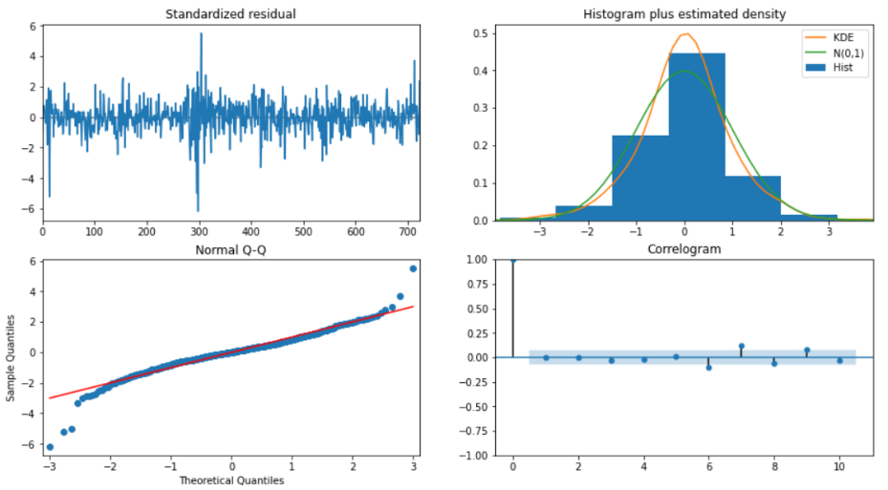
TIME SERIES MODELLING AND FORECASTING
AUTO ARIMA PLOT DIAGNOSTICS
Top left: The residual errors seem to fluctuate around a mean of zero and have a uniform variance.
Top Right: The density plot suggest normal distribution with mean zero.
Bottom left: All the dots should fall perfectly in line with the red line. Any significant deviations would imply the distribution is skewed.
Bottom Right: The Correlogram, ACF plot shows the residual errors are not autocorrelated. Any autocorrelation would imply that there is some pattern in the residual errors which are not explained in the model.

Slide 60
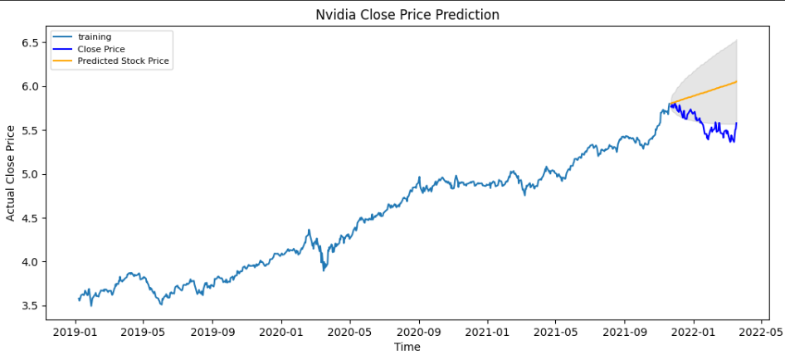
TIME SERIES MODELLING AND FORECASTING
FORECAST MEASURES – SIMPLE FORECAST
This a simple forecasting model using the auto_arima model shown above.
The orange line under the shaded region gives us a glimpse of what the price might look in the future and here it suggests that closing price will show a increasing upward trend for the coming periods.

Slide 61
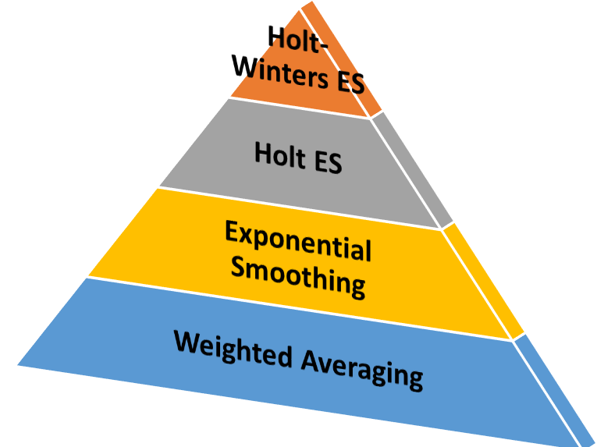
TIME SERIES MODELLING AND FORECASTING
A weighted average is simply an average of n numbers where each number is given a certain weight and the denominator is the sum of those n weights.
Simple Exponential Smoothing as the name suggest is used for forecasting when the data set has no trend or seasonality .
Holt ES can be used to forecast time series data that has trend but fails in the presence of seasonal variations in time series data.
The Holt-Winters ES modifies the Holt ES technique so that it can be used in the presence of both trend and seasonality.
Holt Winter’s time series model is a very powerful prediction algorithm despite being one of the simplest models. It is used in various business problems mainly because of two reasons one of which is the simplest implementation and the model will evolve as business requirement change.
Types of ES :-
Single ES – Simple ES
Double ES – Holt ES (additive and multiplicative)
Triple ES – Seasonality + Trend , i.e. HWES

Slide 62
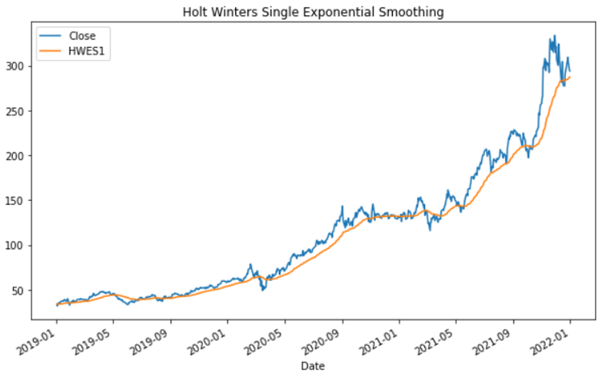
TIME SERIES MODELLING AND FORECASTING
HOLT WINTER – SINGLE / SIMPLE EXPONENTIAL SMOOTHENING
Simple or Single Exponential Smoothening as the name suggest s is used for forecasting when the dataset has no trend and seasonality , i.e. free of both trend and seasonal components.

Slide 63
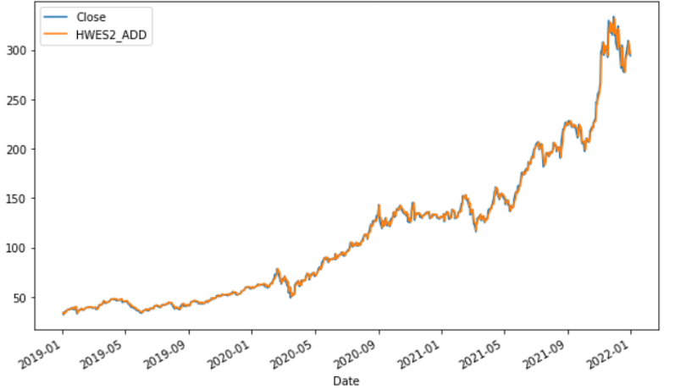
TIME SERIES MODELLING AND FORECASTING
HOLT WINTER – DOBLE / HOLT EXPONENTIAL SMOOTHENING
Holt / Double Exponential Smoothening is a technique that overcomes one of the two above defined shortcomings. It can be used to forecast the data when trend component is present in the data but fails in the presence of seasonal component.
Here the trend is taken as additive component.

Slide 64
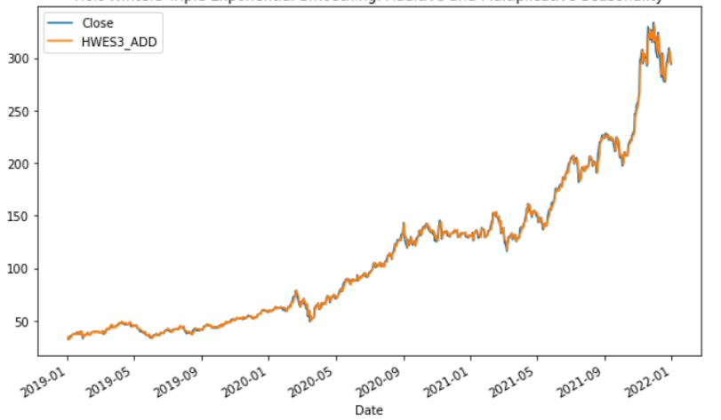
TIME SERIES MODELLING AND FORECASTING
HOLT WINTER – TRIPLE / HOLT WINTER EXPONENTIAL SMOOTHENING
Holt Winter / Triple Exponential Smoothening modifies the Holt Exponential Smoothening technique so that it can be used to forecast when both trend and seasonality is present in the data.
Here the parameters of trend and seasonality has been taken as additive.
Although the graph may look similar to that of Double Exponential Smoothening but difference do exist (towards the end of 2022) which might not be visible unless focused on a particular month of year .
Here the trend and seasonal component is additive in nature.

Slide 65
TIME SERIES MODELLING AND FORECASTING
HOLT WINTER FORECASTING PATTERN
As we already know that there are two variations in the seasonal component and they can be defined as the following under smoothening effect :-
Additive Model :- An additive model is linear where changes over time are consistently made by the same amount. It can be shown as the form Level+Trend+Seasonality+Noise.
Multiplicative Model :- An multiplicative model is non-linear such as quadratic or exponential where changes increases or decreases over time . It can be shown as the form Level*Trend*Seasonality*Noise .

Slide 66

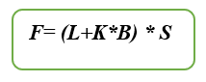
TIME SERIES MODELLING AND FORECASTING
HOLT WINTER FORECASTING PATTERN

Slide 67
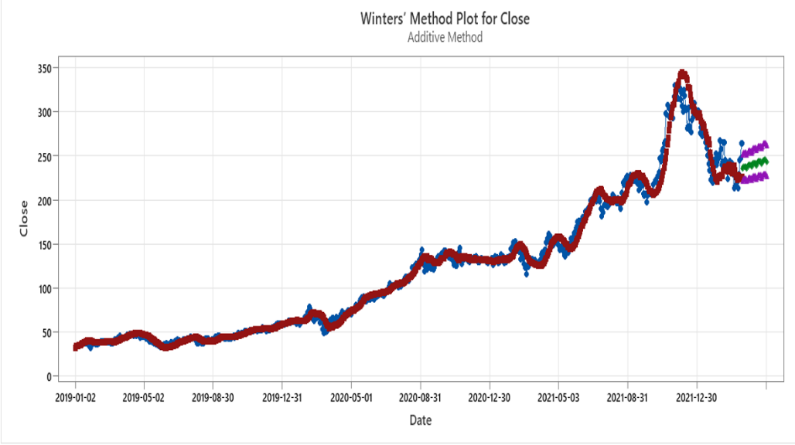
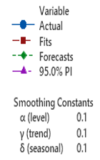
TIME SERIES MODELLING AND FORECASTING
HOLT WINTER FORECASTING FOR 30 DAYS
For the above graph we have taken 0.1(as constant value) for level , trend and seasonality.
Over here we can see the actual stock price has shown a increasing growth with increasing rate over a constant period of time which is then accompanied by a little dip at the later stage and then again started increasing with an increasing rate. The slight dip might due to certain economic conditions that have affected the stock market such as fall of dollar rate or low revenue generated due to low sales , etc.
From the simple forecast (shown above) and triple exponential smoothening closing price shows us a steep growth over a later period of time . So for the time being we can say that both methods of forecast shows the exact result and exact increasing upward trend.

Slide 68
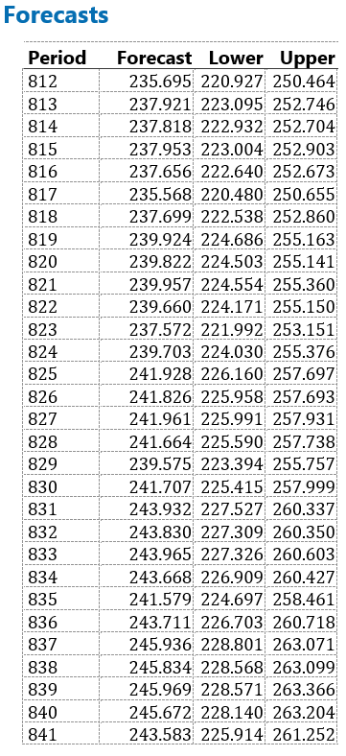
TIME SERIES MODELLING AND FORECASTING
HOLT WINTER FORECASTING FOR 30 DAYS
Forecast shows the estimated forecasted value based on the forecasting equation (HWES).
Lower value shows the lowermost forecasted value calculated fron the trend , seasonality and level of estimation.
Upper value shows the uppermost forecasted value calculated fron the trend , seasonality and level of estimation.

Slide 69
TIME SERIES MODELLING AND FORECASTING
PERFORMANCE METRICS
As we can see our model did quite well , so we can conclude our model fitting and forecast was quite right.
Let us also check the commonly used accuracy metrics to judge forecast results.
MAPE (Mean Absolute Percentage Error) is an error metric used to measure the performance of regression machine learning models. It is a popular metric to use amongst data scientists as it returns the error as a percentage, making it both easy for end users to understand and simpler to compare model accuracy across use cases and datasets.
MAPE returns error as a percentage, making it refreshingly easy to understand the 'goodness' of the error value. The lower the percentage, the more accurate the model.
Around 6.19% MAPE(Mean Absolute Percentage Error) implies the model is about 93.81% accurate in predicting the test set observations.

Slide 70
CONCLUSION
The stock market plays a remarkable role in our daily lives. It is a significant factor in a country's GDP growth.In this paper we use Machine Learning model. By using machine learning we understand that in stock price prediction is used to discover patterns in data . Usually, a tremendous amount of structured and unstructured data is generated from stock markets. Using machine learning algorithms, it is possible to quickly analyze more complex data and generate more accurate results.
While performing the stationary check on the dataset we examined that the dataset is a non stationary one and that it has both trend and stationary component. We perform the detrend and deseasonalize techniques to remove both the component from the dataset. As we were well aware that for a stationary model we can use AR , MA , ARMA model and that for non stationary one we have to use ARIMA OR SARIMA model.
Our model being non stationary one we use the ARIMA (p,d,q) model. Now there are two ways of using ARIMA model :
By choosing the optimal values of p,d,q manually , which might not be so effective , and
Then can use the auto function to automatically detect the best parameters of the ARIMA model.
Once our model fitting has been done we then moved on to forecasting section were we have used Simple forecasting method for the forecast of Nvidia Stock closing price over the period of thirty days and then did the same using Holt Winter’s Exponential Smoothening preferably known as Triple Exponential Smoothening which also gives us the same result like the previous one , i.e. an steep increasing trend over the period of time.
To check the result we used the performance metrics and from there we can conclude that our model did quite well and the accuracy rate was far above ninety percent.

Slide 71
FUTURE STUDY
In financial markets, a machine learning (ML) has become a powerful analytical tool used to help and
manage investment efficiently. ML has been widely used in the financial sector to provide a new mechanism that can help investors make better decisions in both investment and management to achieve better performance of their securities investment.
We the evolving nature of ML and the growth of Deep Learning (DL) , preferably Neural Networks one can apply them and obtain a more better and good quality model.
Besides Time Series and Linear Regression we can used models like SVR, KNN, XGBoost, LightGBM from ML and using the DL one can apply LSTM on Time Series to obtain high efficient models.
Such ML models can later be deployed on clouds such as Heroku , GCP , Azure , AWS EC2 , etc to make a more production and user interactive based model.

Slide 72
REFERENCES
Central European Economic Journal.
Linear regression of Machine learning by JasonBrowniee.
Stock Market Prediction Using Machine Learning Techniques : A Decade Survey on Methodologies, Recent Developments, and Future Directions(MDPI).
Kaleb Phipps , Martin Ratz , Dirk Muller , Veit Hagenmeyer , Ralf Mikut | Feb , 2022 | REVIEW OF AUTOMATED TIME SERIES PIPELINE.
Julien Siebert , Janek Grob , Christof Schroth | June , 2021 | A Systematic Review Of Python Packages for Time Series Analysis.
Wes McKinney , Josef Perktold , Skipper Seabold | 2011 | Time Series Analysis in Python with Statsmodels.

Slide 73

THANK YOU!!!!!!!!

